Slide 1
Strategies for Reuse of Launch Vehicle First Stages
Are any first stage reuse strategies economically worthwhile?
… under what mission, market, and technological conditions?
Matthew Vernacchia
Kelly Mathesius
2018-10-03

Slide 2
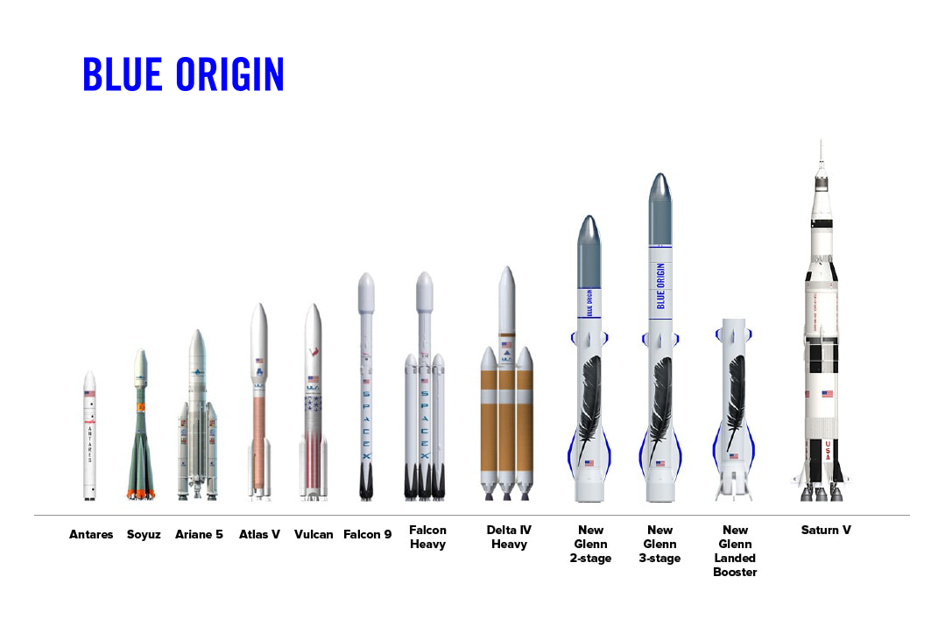
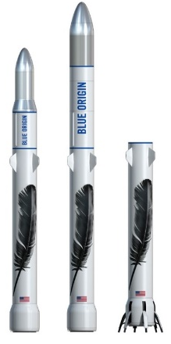
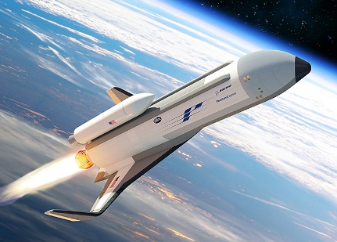
Some launch providers are moving towards 1st stage reusability
Will providers of expendable launch vehicles be left behind?
… or are these development efforts wasting billions?
SpaceX
Falcon 9
Operational
Blue Origin
New Glenn
In development
ULA
Vulcan SMART reuse
In development
Boeing
XS-1 Phantom Express
In development
Image credits: Space Exploration Technologies, Blue Origin, United Launch Alliance, and The Boeing Company
Intro | Methods | Results | Conclusion

Slide 3
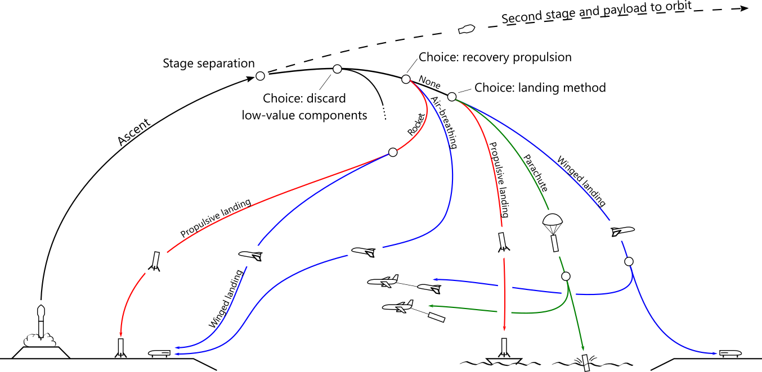
Many first stage reuse strategies have been proposed …
… but their performance and cost have not been (publically) compared under a common framework
… and there remains controversy as to which, if any, are economically worthwhile
Examples:
Falcon 9
USAF RBS
Baikal
Vulcan SMART
Falcon 9
New Glenn
Ares I
XS-1 Phantom Express
Launch site recovery
Downrange recovery
Intro | Methods | Results | Conclusion

Slide 4
Cost per flight is estimated with performance and cost models
mission orbit
strategy
payload size
Performance Model
Estimate vehicle size
+uncertainty (Monte Carlo)
masses
Estimate operations and refurbishment costs
Estimate 2nd stage production cost
Estimate 1st stage production cost
Cost per flight
Cost Model
Estimate 1st stage production amortization share
+uncertainty (Monte Carlo)
Estimate cost per flight
Intro | Methods | Results | Conclusion

Slide 5
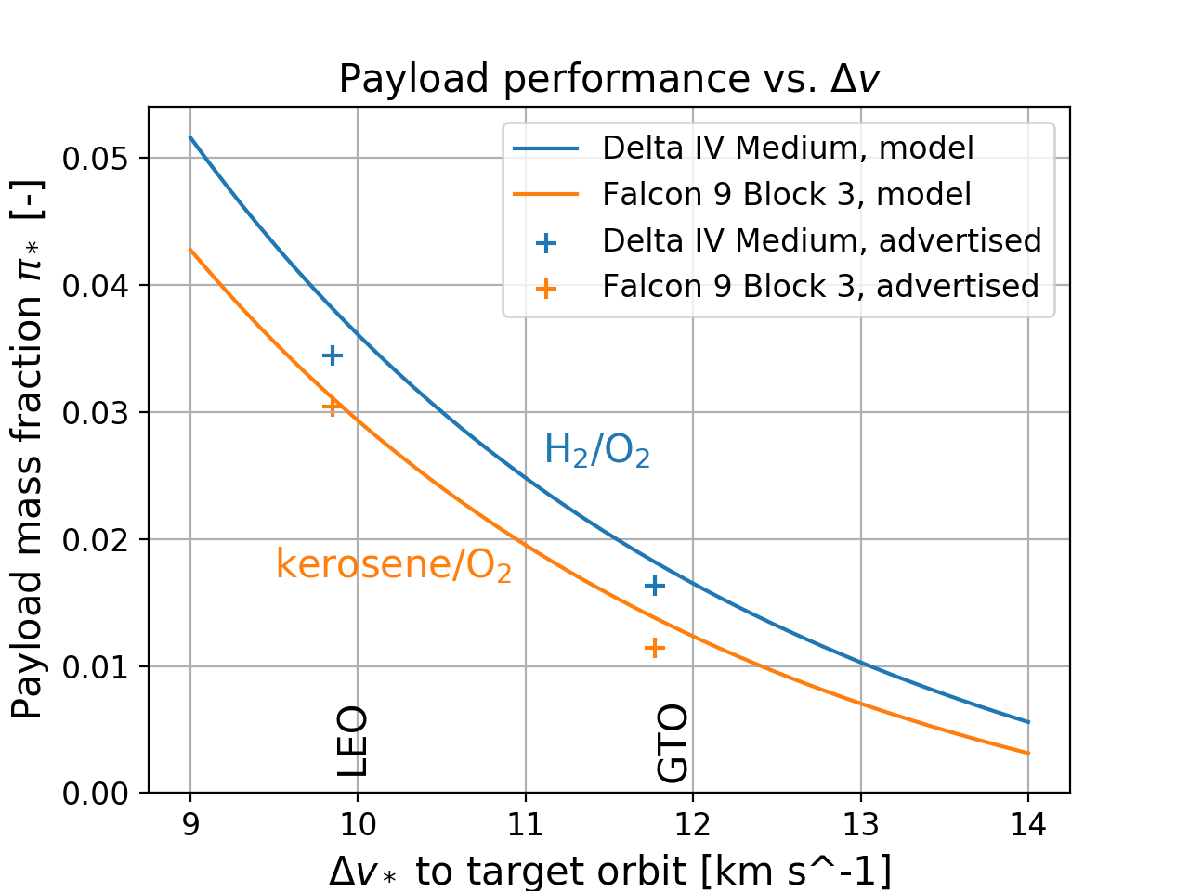

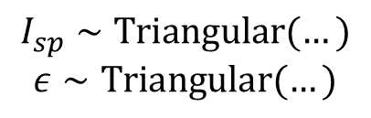
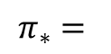
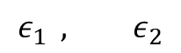
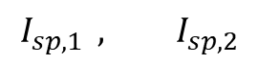
Payload capacity is set by $I_{sp}$ and inert mass
Specific impulse
$$I_{sp,1 } , I_{sp,2}$$
$$π_{∗}=$$
Tsiolkovsky
$$ε_{1 } , ε_{2}$$
Inert mass fraction
Payload mass fraction
Technology limits achievable specific impulse and inert mass fraction
$$I_{sp}∼Triangular(…)$$
$$ε∼Triangular(…)$$
Based on modern
kerosene/O₂ stages
Intro | Methods | Results | Conclusion

Slide 6
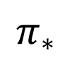
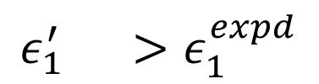
Reuse adds mass to the first stage, decreasing payload capacity
Recovery hardware
$$ε_{1}^{′} >ε_{1}^{expd}$$
$$π_{∗}$$
Recovery propellant
“unavailable” mass fraction
expendable inert mass fraction
Payload mass fraction
For each reuse strategy:
Recovery hardware distribution fit to detailed studies
Recovery propellant calculated fro maneuvers with dispersed parameters
Model output: element masses to cost model
Intro | Methods | Results | Conclusion

Slide 7
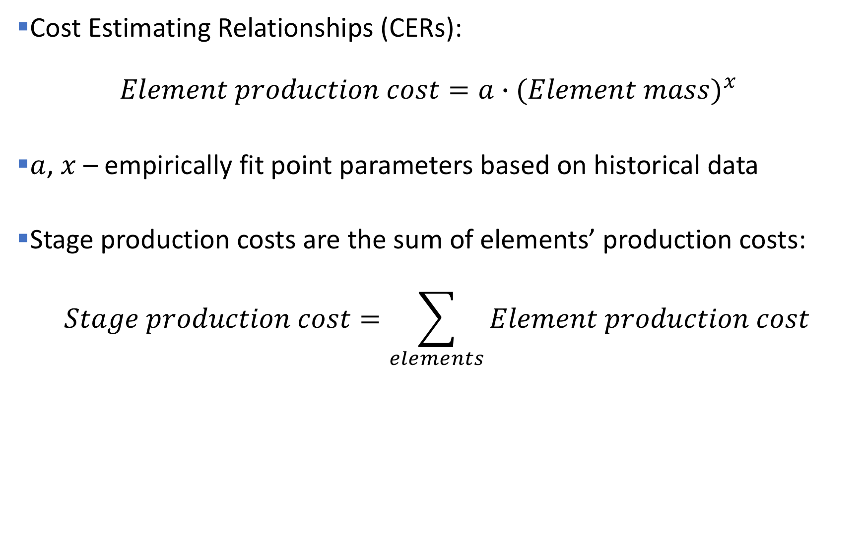
TRANSCOST model relates masses to costs
Cost Estimating Relationships (CERs): $Element production cost=a∙{(Element mass)}^{x}$
$a$, $x$ – empirically fit point parameters based on historical data
Stage production costs are the sum of elements’ production costs:
$$Stage production cost=\sum_{elements}{Element production cost}$$
Intro | Methods | Results | Conclusion

Slide 8
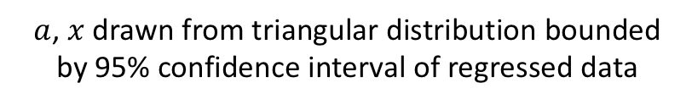
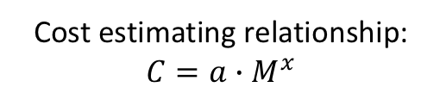
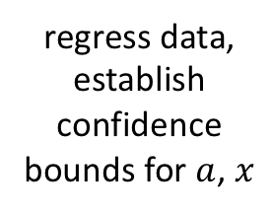
Quantifying uncertainty for TRANSCOST parameters
digitize TRANSCOST historical data
regress data, establish confidence bounds for $a$, $x$
Cost estimating relationship: $C=a∙M^{x}$
$a$, $x$ drawn from triangular distribution bounded by 95% confidence interval of regressed data
Intro | Methods | Results | Conclusion

Slide 9
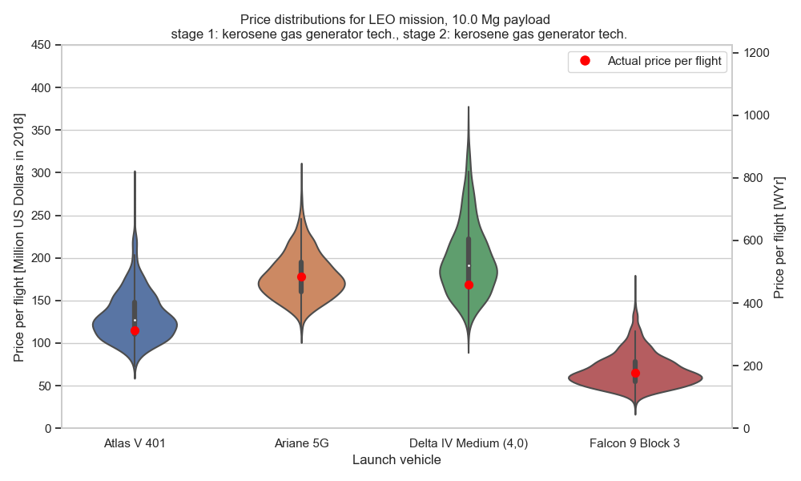
Cost model estimates are credible
Intro | Methods | Results | Conclusion

Slide 10
Downrange propulsive landing has lowest estimated cost
Lowest estimated cost
Intro | Methods | Results | Conclusion

Slide 11
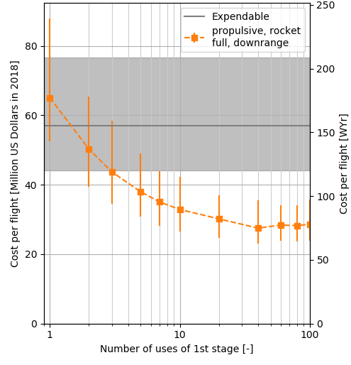
Cost decreases with number of reuses … up to a point
Confidently cheaper than expendable:
> ~5 uses
Realize most of cost savings:
> ~20 uses
Cost increases due to refurbishment:
> ~60 uses
5
20
60
LEO mission, 10 Mg payload
stage 1&2: kerosene gas gen. tech.
Intro | Methods | Results | Conclusion

Slide 12
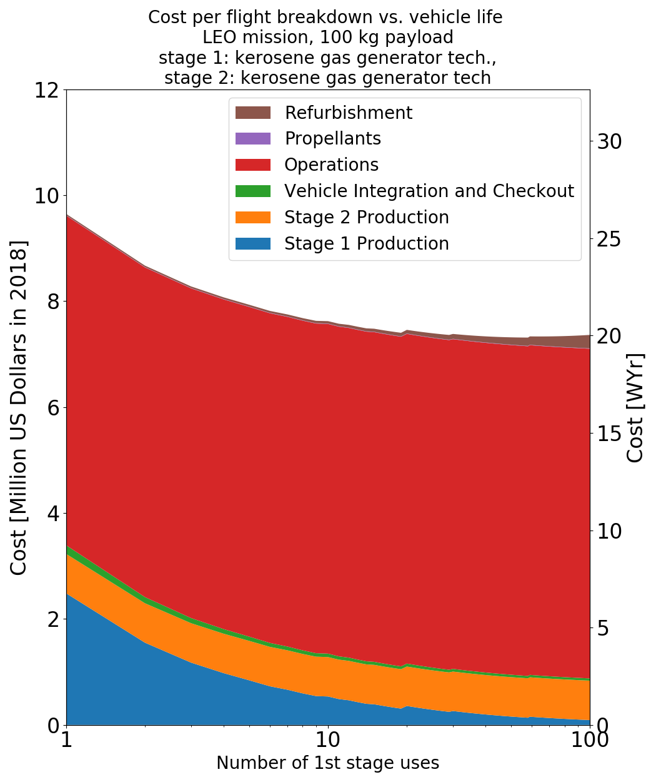
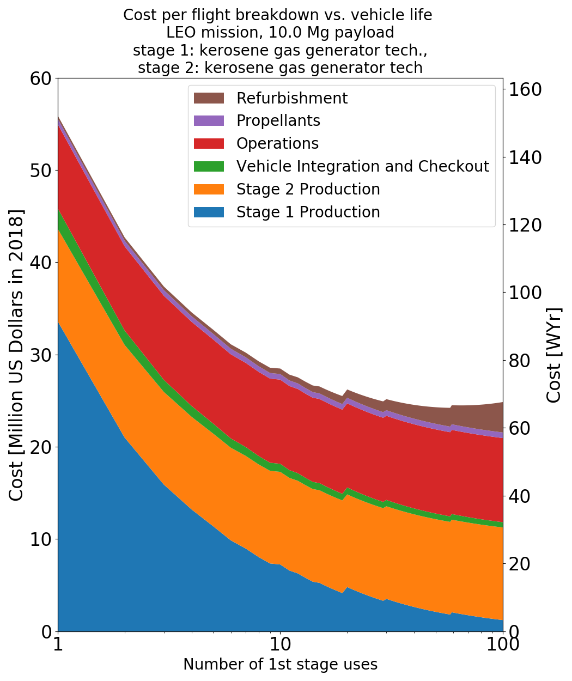
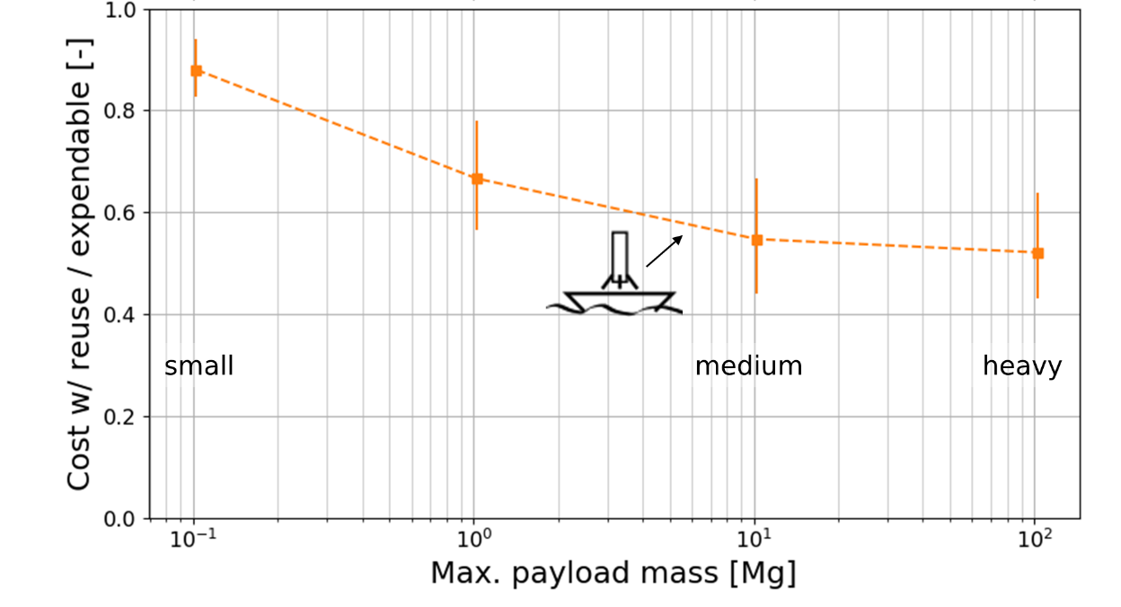
Reuse is more worthwhile for medium to heavy launch vehicles
Small 100 kg payload
Medium 10 Mg payload
LEO mission
stage 1&2: kerosene gas gen. tech.
Intro | Methods | Results | Conclusion

Slide 13
Future work: development costs
This work only addressed recurring costs (cost-per-flight)
But development costs are also significant
Area for further study
Hypothesis: high launch rates are needed to justify developing reusability
Intro | Methods | Results | Conclusion

Slide 14
Conclusion: Some 1st stage reuse strategies, particularly downrange propulsive landing, can reduce cost per flight
Downrange propulsive landing is likely the lowest-cost strategy
Partial (engines-only) reuse strategies have small potential savings
Winged stages have uncertain (and probably high) production costs
Only worthwhile for medium-large launch vehicles, where first stage production costs dominate
Intro | Methods | Results | Conclusion

Slide 15
Questions?
Falcon 9
USAF RBS
Baikal
Vulcan SMART
Falcon 9
New Glenn
Ares I
XS-1 Phantom Express
Examples:
Launch site recovery
Downrange recovery

Slide 16
Backup Slides

Slide 17
All reuse strategies reduce the payload mass fraction
Intro | 1. Production costs | 2. Lowest-cost strategy | 3. Conditions for reuse viability | Conclusion

